Slide 1
TFO
Report Design Using Microsoft Access

Slide 2
What CAN a Report Can Do that a Query Cannot?
Added formatting options:
Heading vs. Detail areas.
Differing font sizes and faces.
Allows display of both detail and sub-totals or totals.
Built in functionality to handle paging.

Slide 3
How to Build Reports with the Wizard (Step 1)
In the menu at the top of the window, click Create.
Click on the Report Wizard icon in the toolbar.

Slide 4
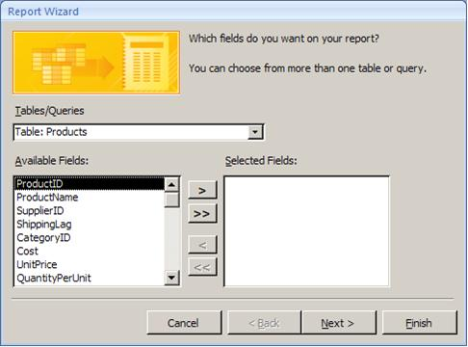
How to Build Reports with the Wizard (Step 2)
Select the table or query on which the report will be built.
Use the buttons in the middle of the screen to move the fields you want from Available Fields to Selected Fields.

Slide 5
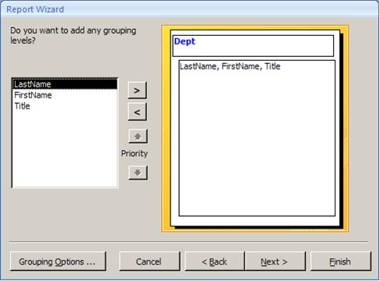
How to Build Reports with the Wizard (Step 3)
Choose how you want the records grouped on report:
Grouping has to do with both sorting the records and with formatting them on the report.
Groupings can be given their own headings and footers.

Slide 6
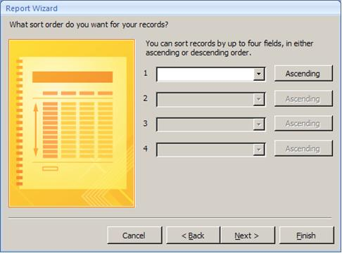
How to Build Reports with the Wizard (Step 4)
Sorting arranges the records within groups:
Select field to sort by from the drop down.
Can also click Ascending/ Descending button to make the sort ascending or descending.

Slide 7
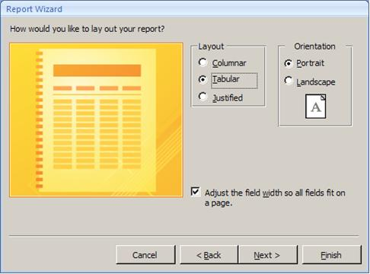
How to Build Reports with the Wizard (Step 5)
Choose the layout and orientation of your report:
Click on Columnar, Tabular, or Justified and watch the changes in the thumbnail diagram to see how each works.
Be careful with Adjust Field Width.

Slide 8
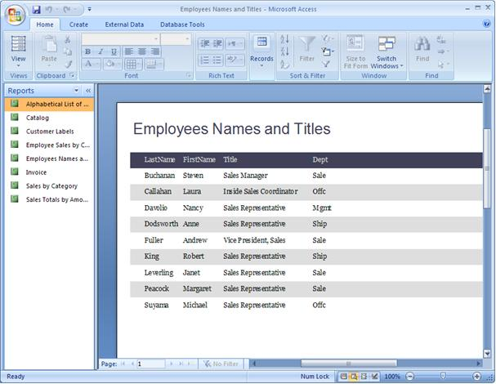
A Finished Report

Slide 9
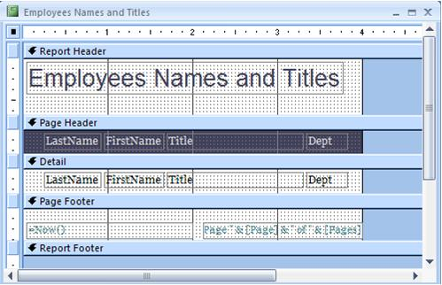
Report in Design View
Use the report design view icon and the print preview view icon in the lower-right corner of the screen.
Compare to Prior Slide.
Labels show static text.
Text boxes show data from each record.

Slide 10
Report Bands
Report Header | Prints once at the top of the report
Page Header | Prints at the top of each page of the report. On page 1, it prints just under the Report Header.
Detail Band | Prints over and over for each row of data.
Page Footer | Prints at the bottom of each page of the report.
Report Footer | Prints once at the bottom of the report. It always prints on the last page following the last line of detail and below the Page Footer.

Slide 11
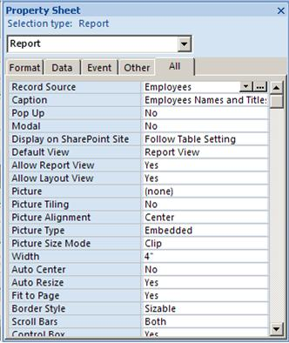

Property Sheet
Every object on a report has properties:
Every label.
Every text box.
Every line.
Every band.

Slide 12
Editing Labels
Click once on the label.
Click again inside the label to edit its text.
Or view the properties for the label and change the Caption property.

Slide 13
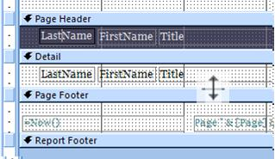
Increasing or Reducing Space in a Band
Position the mouse at the top of the Page Footer band (just below the band to resize).
The mouse cursor should change to what is shown below.
Hold down the left mouse button and drag the mouse up or down.

Slide 14
Sizing Objects
Click in the middle of a text box or label to select it:
You will notice the little buttons on each corner and side. These are called sizing handles and are used to resize the object.
Position the mouse on any of the buttons (cursor will become a two-headed arrow), then drag to resize.

Slide 15

Moving Objects
Click in the middle of a text box or label to select it.
Position the mouse on the line of the box anywhere other than on one of the sizing handles:
The mouse cursor will change.
When you see this, you can move the entire text box.
Hold down on the left mouse button and drag to move the object.

Slide 16

Aligning Objects
Select two or more objects. You can do this either by holding down the shift key while clicking on multiple objects or dragging a marquee around multiple objects.
Click on Arrange in the menu at the top of the screen.
Click on one of the Control Alignment icons.
Access always moves the selected objects to the rightmost or leftmost or topmost or bottommost it can (i.e. if you click on Left, it will move all objects other than the leftmost object to be aligned with that object).

Slide 17

Group, Sort, and Total
Click on Design in the menu.
Click on the Group & Sort icon in the toolbar. The Group, Sort, and Total box will appear at the bottom of the screen.
In the "Group on CompanyName" band, click on More.
Click the dropdown beside where it says "without a footer section" and change it to "with a footer section."

Slide 18



Adding a Text Box for a Subtotal
Click the text box icon in the toolbar. Then click in the report where you want the text box placed.
View the Property Sheet for the text box.
In the Control Source property, type: =Sum(UnitsInStock).
Align the text box if needed.
If needed, size the text box to match. Click the To Narrowest icon in the Size section of the toolbar.

Slide 19
Report Design Steps
Interview users to determine their report needs.
Create prototypes of reports on paper or with a CASE tool prior to putting in the work of actually developing the report.
Get feedback from the users on the prototypes.

Slide 20
Report Design Guidelines
Every report should have a title.
Every report should be date and time-stamped so the user knows how current the information is.
Every piece of information on the report should be labeled. Labels should be short and descriptive. Avoid abbreviations if possible. All abbreviations should be explained in a legend except for extremely common abbreviations, such as ID.
Normally columns of numbers should be right-justified and columns of text should be left-justified. Alignment should be tested with users for their preferences.
Data, such a telephone numbers, social security numbers, and dates, should be formatted to match users' norms.

Slide 21
Report Design Guidelines (cont.)
Information should be balanced on the report - not too crowded and not too spread out.
Frequently, rows represent groups of data. Those groups should be logically grouped on the report.
Page headers and/or footers should appear on every page and include the report title, date and time, and page numbers.
The end of the report should be indicated to ensure that users have the entire report. This can be done with *** END OF REPORT *** in the report footer. This can also be accomplished by specifying page numbers as: Page x of y.

Slide 22
Exercise
Create a query that lists the CategoryName, ProductName, and UnitsInStock of all products in the Beverages category. Save the query.
Create a report using the report wizard to show all the fields of this query.
Do not use any type of grouping, sort (ascending) on the Product Name.
Make the report tabular and portrait in layout.
Title your report "Beverages."
Select the title label, bring up the Properties box, and change the title Font Name to Script and Font Size to 28.
Add a total for UnitsInStock at the bottom of the report.

